Slide 1

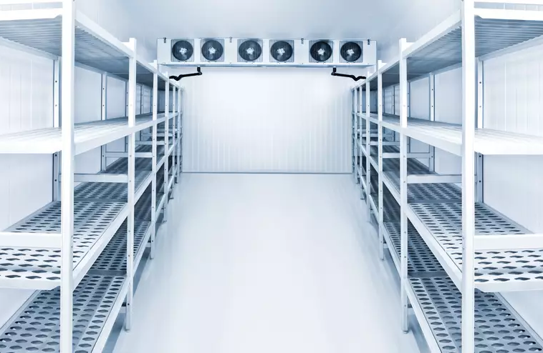

Parametric Study of a Walk-in-Freezer
“Exploring Sustainable Solutions for Cold Storage”
You found me
Lecture: 5.06.M123 Renewable Energy Heat
WiSe 23/24
Juan Manuel Boullosa Novo
Alberto Jimenez Haro
Emre Atalan
08.02.2024
[1]

Slide 2
Motivation
In walk-in-freezer systems, comparing different refrigerant´s COP is crucial to find more efficient solutions.
Enhancing the efficiency of a commercial walk-in freezer can lead to significant reductions in operating costs.[2]
Insulation and sealing is one of the most important strategies to minimize the heat transfer losses.
Adjusting temperature setpoints based on seasonal changes in ambient temperatures can help optimize energy usage.
E
Notes:
Emre:

Slide 3
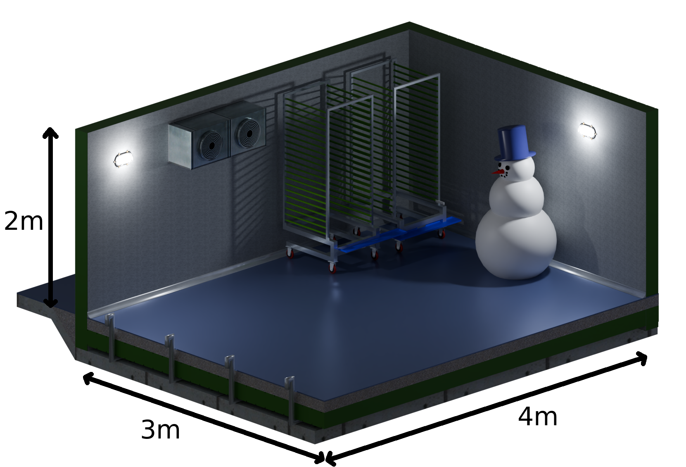
Location and Measurements
Location: Kuzey Kebap Haus,
Hamburg, Germany
Dimension of the cold room 4✕3✕2 [m]
Insulator area of the room 52 m²
Desired temperature inside the room -18 ℃
Heat Pump used JAE-200P (fictional)
Compressor Efficiency 80%
E
Notes:
Emre:

Slide 4
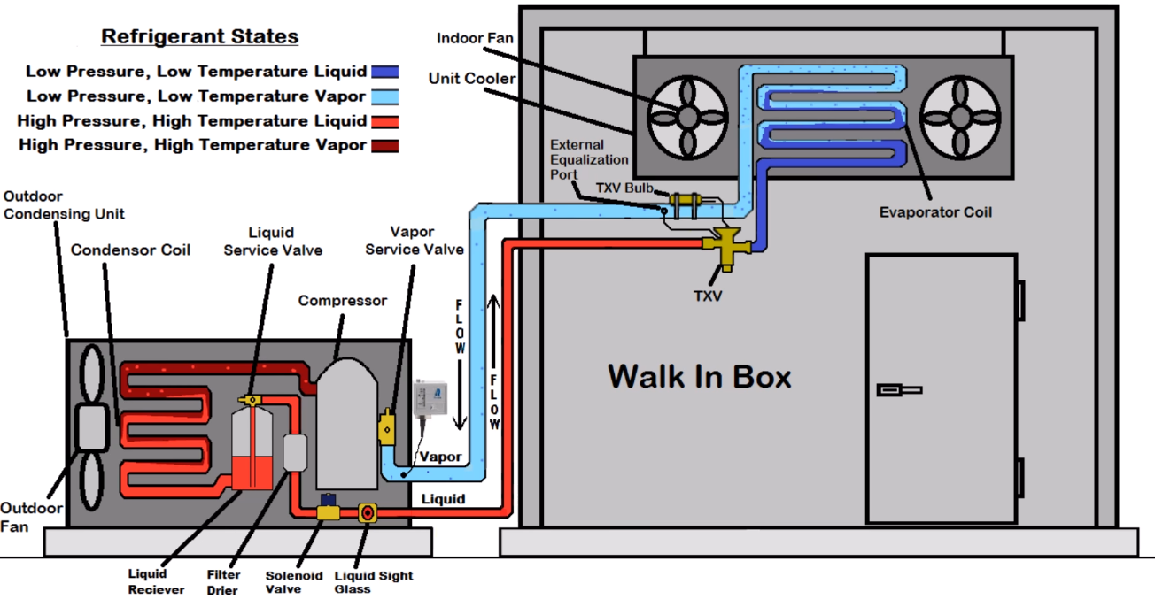
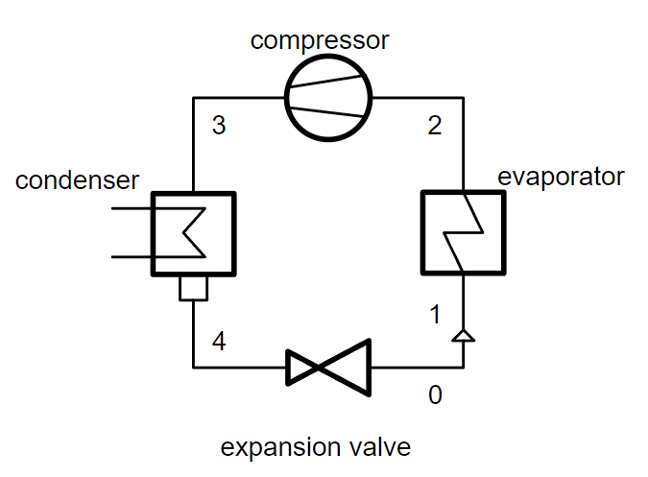
Walk-In Cooler Refrigeration Cycle
[5]
2
1
3
[6]
4
3
2
4
1
E
Notes:
Emre: Important explanation for heat pump vs refrigeration cycle. Evaporator vs Condenser

Slide 5
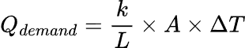
Cooling Demand Calculation
Cooling demand in walk-in-freezer systems refers to the thermal load imposed on the refrigeration system to maintain the desired low temperature within the freezer enclosure.
k = thermal conductivity coefficient
L = thickness of the material
A = insulator area (all the surfaces: walls, ceiling and floor)
ΔT = temperature difference between desired temperature and outside temperature in Kelvin
E
Notes:
We choose the insulation material with as low k values as possible. Thus, cooling demand and heat transfer to the outside is reduced.
to keep as much cold air in as possible.

Slide 6
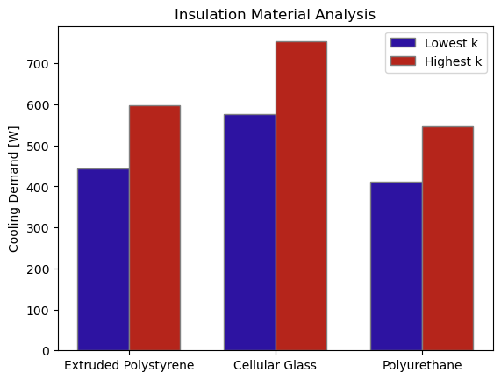
Comparing Insulation Materials for Walls
There are three common types of insulation materials used in Industrial Refrigeration Systems:
Extruded Polystyrene
(k between 0.025 and 0.040W/m∙K)
Cellular Glass, Polyisocyanurate ‘PIR’
(k between 0.038 and 0.055W/m∙K)
Polyurethane ‘PU’
(k between 0.022 - 0.035W/m∙K)
For the floor we will use concrete
(k ~ 0.11W/m∙K)
A
Notes:
Alberto: (k thermal conductivity coeff)
(The graph means that) with the least amount of heat, we reach our desired T for the inside freezer.
We finally select: a) Walls + Ceiling: Polyurethane
b) Floor: Concrete
💩
💩
💩
💩

Slide 7
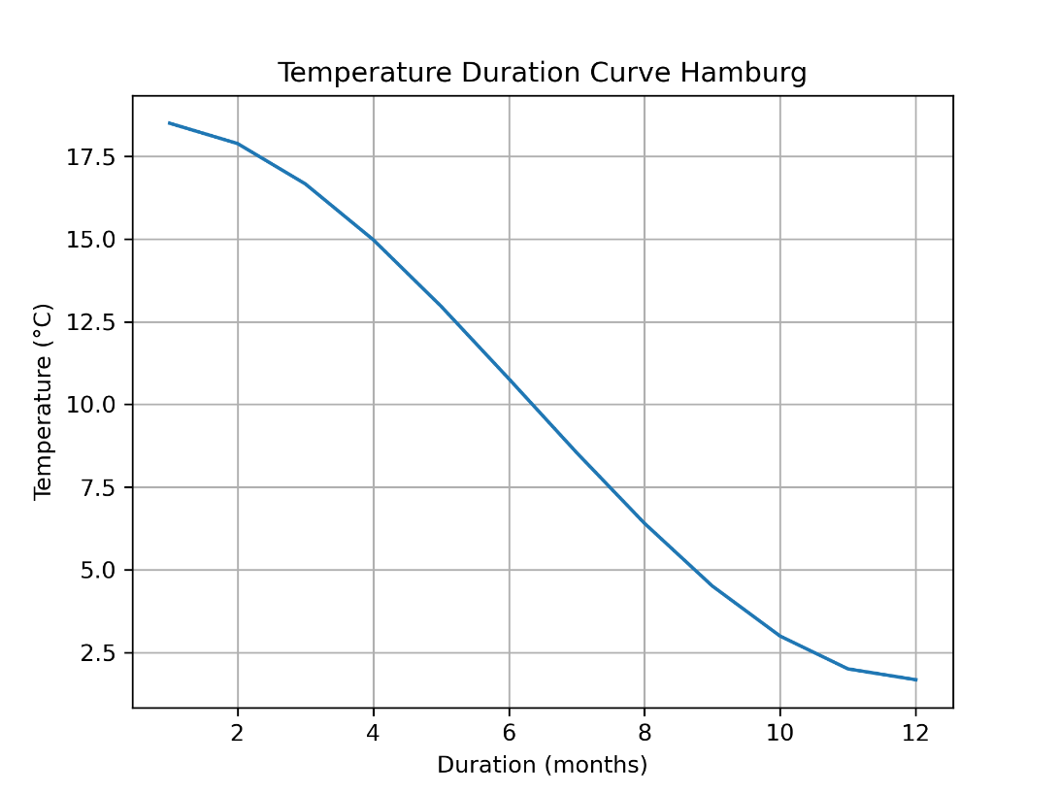
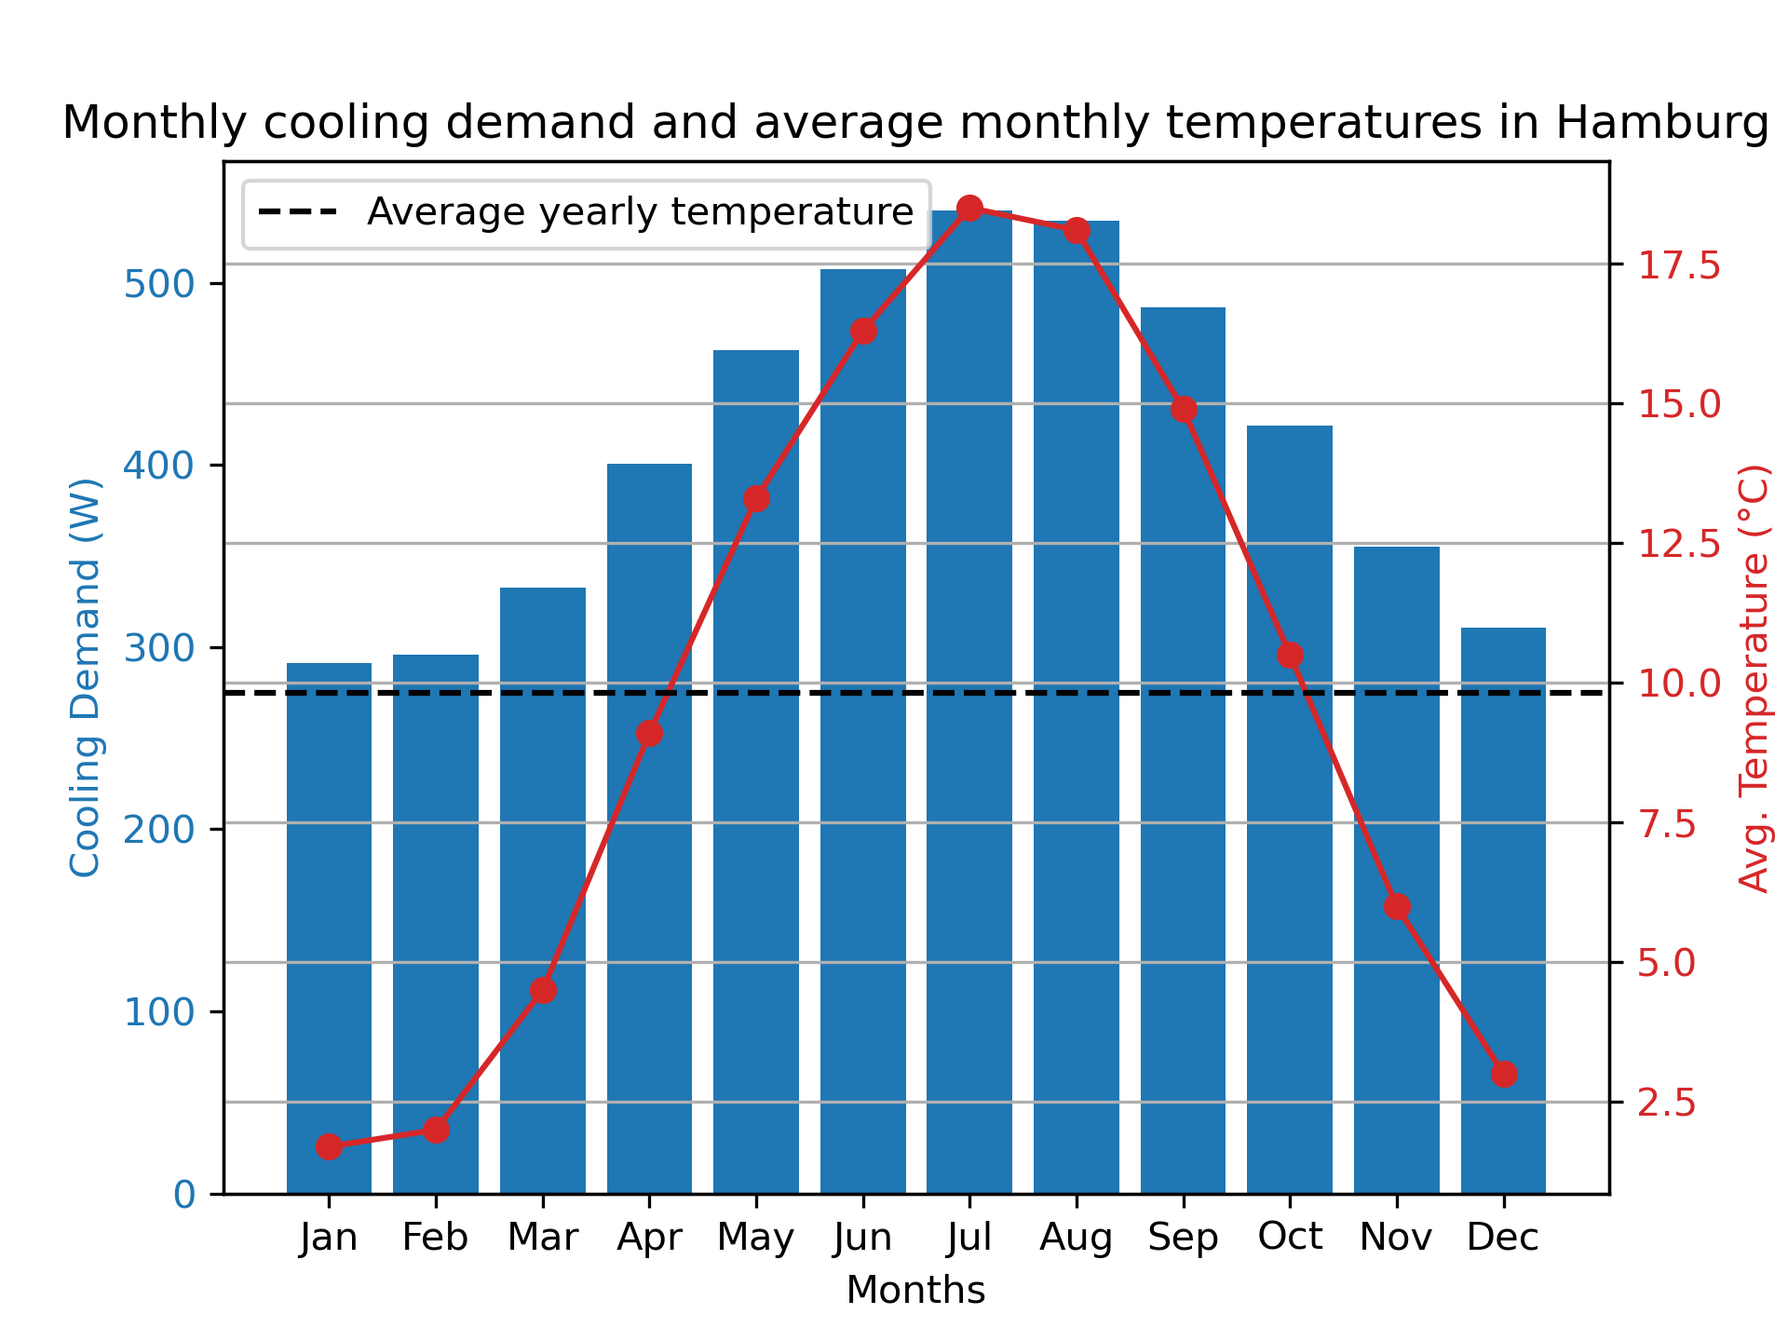
Cooling Demand
Duration Curve
A
Notes:
Alberto:
Talk about chosen temperature
Average temperature (dotted line) = 9.83 C

Slide 8
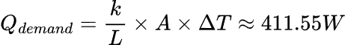
Choosing Refrigerant Temperatures
Evaporator Temperature [℃] | Condenser Temperature [℃]
-38 | 19.8
-36 | 21.8
-34 | 23.8
-32 | 25.8
-30 | 27.8
-28 | 29.8
-26 | 31.8
-24 | 33.8
-22 | 35.8
-20 | 37.8
Select Average Yearly Temperature (9.83 ℃)
Set midpoint to +20 ℃ for condenser temperature and -10 ℃ for evaporator
Consider range of ±10 ℃ from the midpoints
Calculate Cooling Demand for the COP analysis
Consider materials thermal conductivity (k)
Consider Area of heat transfer surface
A
Notes:
Alberto:
We will then select T for the Evaporator and the T for Condenser.

Slide 9
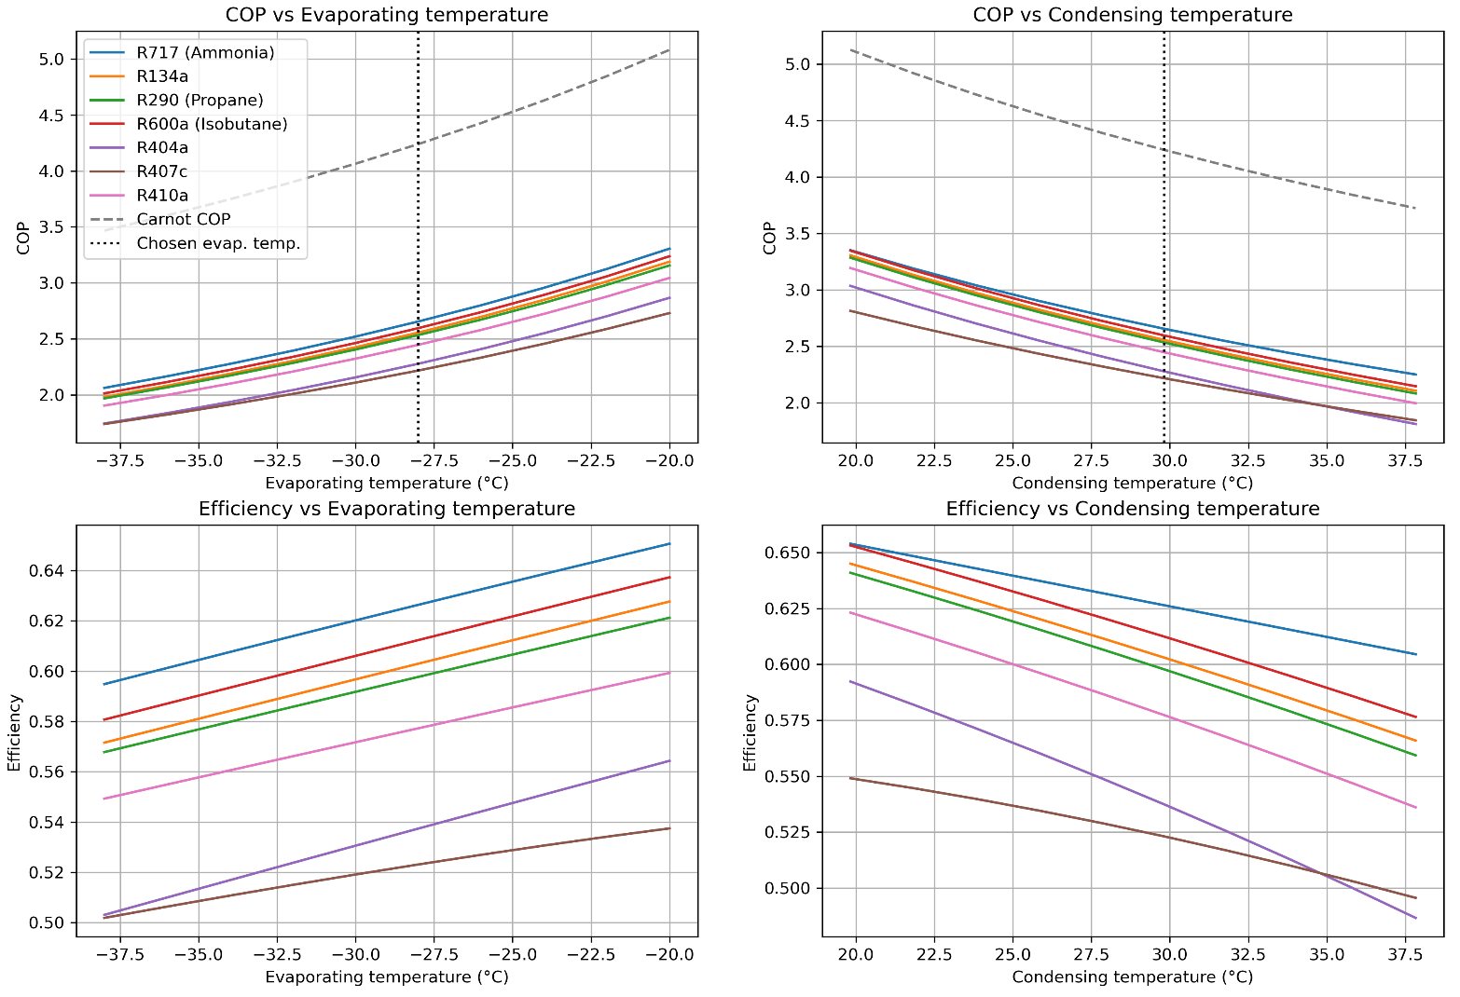
COP Refrigerant Analysis
A
Notes:
Alberto:
1. We selected an adequate single value of temperature that is the yearly average in Hamburg for our steady state analysis.
2. We extrapolated for a evaporator and condenser temperature and range of values around it.
3. Perform the COP and Efficiency analysis for each refrigerant
Point out the Ammonia and R290 lines.

Slide 10
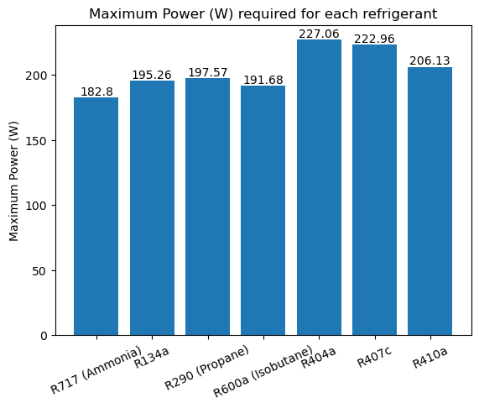
Selection of compressor power
From previous refrigerant analysis we also obtained the maximum compressor power associated to each refrigerants.
To fix the power for our compressor model, we will need to select a refrigerant.
A
Notes:
Alberto:

Slide 11
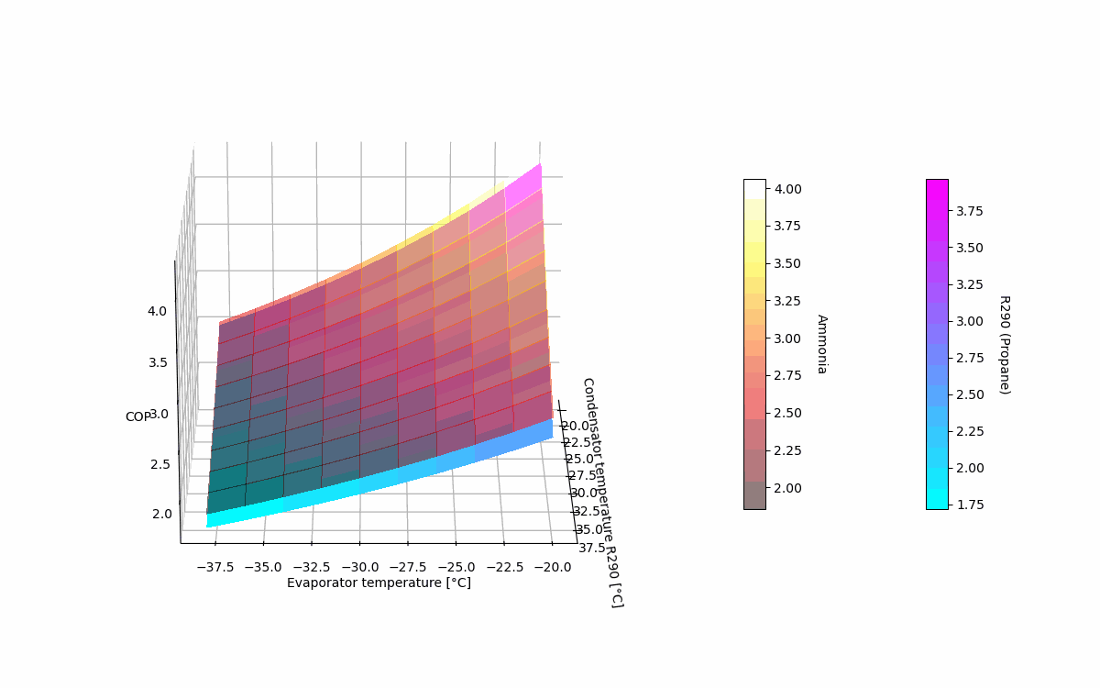
A
Notes:
Alberto: Explain how the high COP relates to low evap temp and high condens temp.
Top surface: Ammonia Bottom surface: Propane

Slide 12
Comparing Refrigerant Fluids
Fluorinated greenhouse gasses, such as hydrofluorocarbons (HFCs) like R404a and R134a, perfluorocarbons (PFCs), sulfur hexafluoride (SF6), and nitrogen trifluoride (NF3), are no longer preferred in refrigeration systems for food storage due to their negative environmental impact.[3]
R290
(Propane)
NH3
(Ammonia)
Pros
Cons
Pros
Cons
Low Global Warming Potential (GWP=3) [4]
Zero Ozone Depletion Potential (ODP=0) [4]
High Energy Efficiency [4]
Highly flammable [4]
< other HC refrigerants [3]
Zero Global Warming Potential (GWP=0) [4]
Toxic [4]
Additional cost in terms of the safety measures [4]
Zero Ozone Depletion Costly system [4]
Potential (ODP=0) [4]
Higher energy efficiency [4]
Use is limited to specific applications. [4]
Non-toxic [4]
Higher refrigeration
capacity [4]
J
Notes:
Juan: Let’s looks at the pros and cons of our 2 protagonists: Propane and Ammonia
Overall we can see that Ammonia is slightly better in terms of sustainability, energy efficiency and refrigeration capacity,
on the other hand, it is Toxic and can create a very costly system, unlike propane. Overall looks that Ammonia is a better refrigerant.

Slide 13
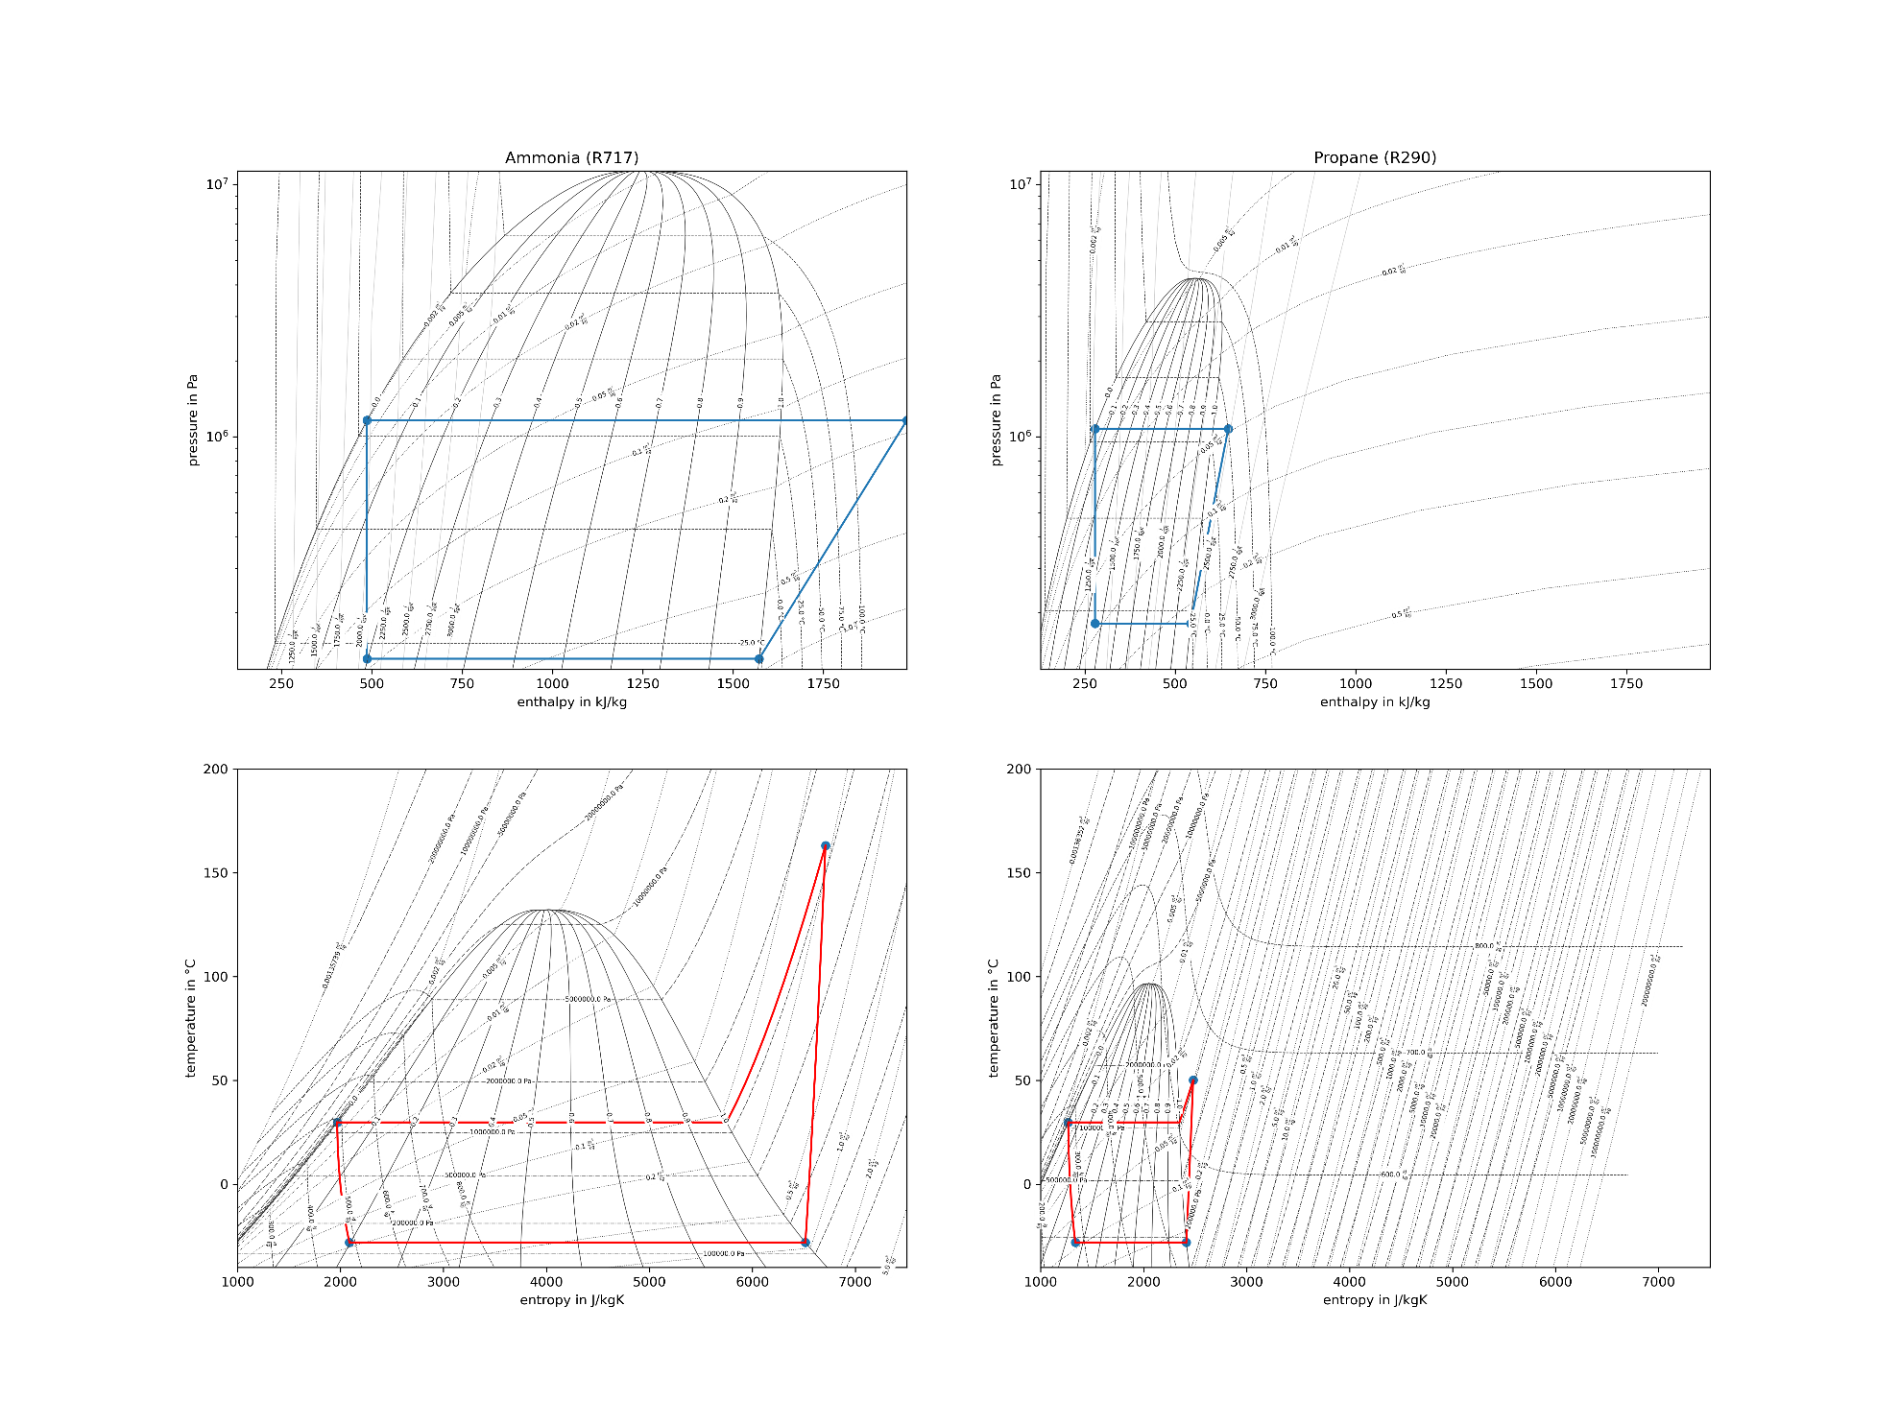
P-h Diagram
T-s Diagram
J
Notes:
Juan: However , after plotting the T-s and P-h diagrams for both refrigerants we can obtain additional information
Turns out Ammonia reaches temperatures upwards of 160 C post-compression and have much higher ranges in
temperature, enthalpy and entropy compared to propane.

Slide 14
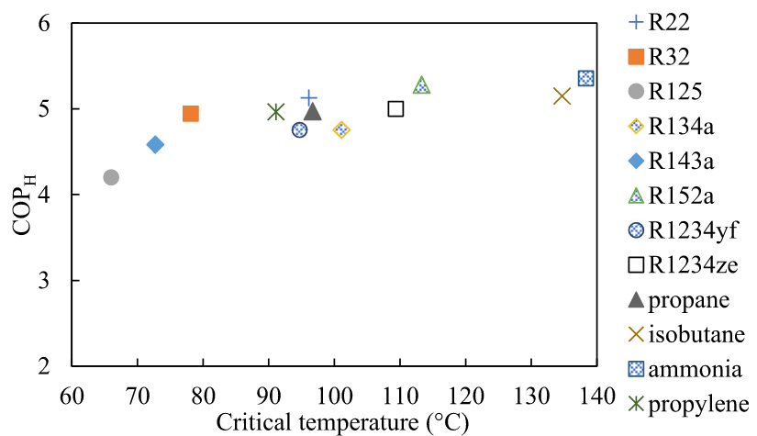
Critical temperature of different refrigerants
[7]
J
Notes:
Juan: Show why we chose PROPANE (R290)
This (160 C), can exceed the critical temperature of the refrigerant (around 138 C), interfering in the correct functioning and safety of the heat pump
Avoiding these temperatures is possible, but it is a compromise on our system design
We decide to instead choose R290 (propane)

Slide 15
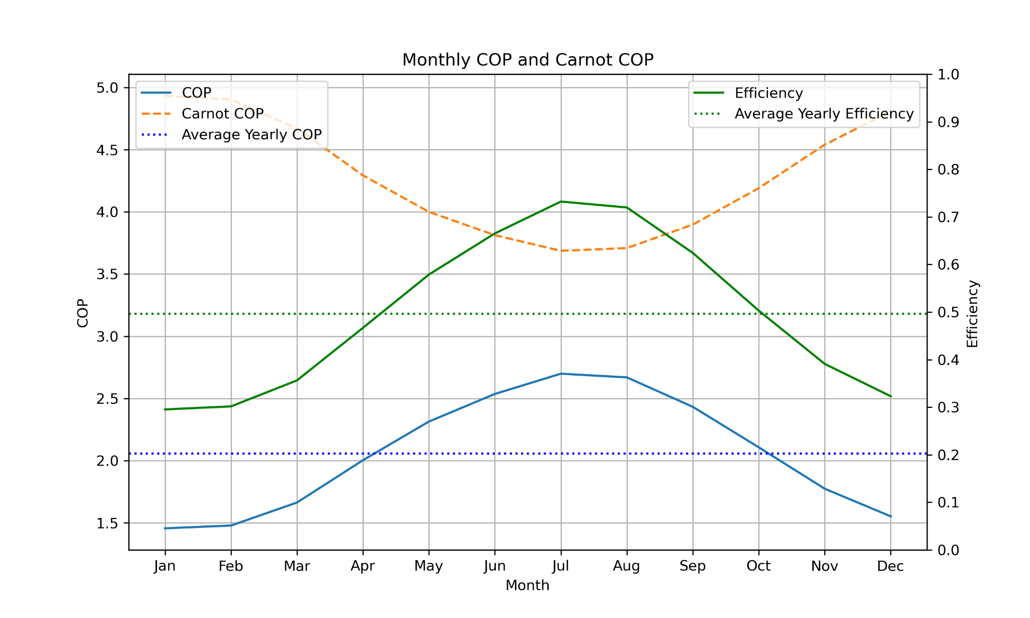
Monthly Coefficient of Performance (COP) for 200W
Refrigerant = Propane R290
Compressor = 200 W
Calculate all COP and efficiencies of the year
Find mean values
COP_{mean}= 2.06
Eff_{mean} = 0.50
J
Notes:
Juan: Explain how we chose the 200 W compressor
After choosing Propane as refrigerant, compare with Maximum Power plot and choose adequate compressor
Compressor has power of 200 W
Use this power to calculate yearly COPs and Efficiencies.
Get the nominal values of COP and EFFICIENCY.

Slide 16
Conclusion
Effect of insulation materials on cooling demands.
COP and efficiency analysis results ~ Found out the effects of varying the temperatures, the heat demand and refrigerants.
Refrigerants used: Chose R290 for the walk-in freezer system for its environmental friendliness, energy efficiency, and regulatory compliance, with proper safety measures in place for handling its flammability.
The importance of using T-s and P-h diagrams to explore the conditions of the refrigerants in the heat cycle and find suitability.
Future optimisation possibilities: Focus on improving energy efficiency, enhance temperature control, and integrating smart technologies for better monitoring and management. Consider other system setups that would allow for other more efficient refrigerants like ammonia to be used safely.
J
Notes:
Juan:R290: Propane is flammable and requires careful handling and storage.
However, it has a lower flammability limit compared to other hydrocarbon refrigerants, reducing the risk of ignition.
Ammonia also can meet many requirements and is widely used in industrial refrigeration due to its efficiency and also ammonia has a lower flammability compared to some other refrigerants,however it is indeed toxic. So, exposure to high concentrations can pose serious health risks.
Important: Importance of choosing the right refrigerant, how important is the usage of the TS and PH diagrams for refining the choice and avoiding potential dangers.

Slide 17
Table of parameters for walk-in freezer
Dimension of walk-in freezer: | 4✕3✕2 [m]
Total surface area: | 52 m²
Desired temperature inside the room: | -18 ℃
Heat pump model: | JAE-200P
Compressor efficiency: | 80 %
Wall material: | Polyurethane (10 cm)
Ceiling material: | Polyurethane (13 cm)
Floor material: | Concrete (20 cm)
Average Yearly Temperature: | 9.83 ℃
Condenser temperature midpoint: | +20 ℃
Evaporator temperature midpoint: | -10 ℃
Selected Condenser Temperature: | 29.8 ℃
Selected Evaporator Temperature: | -28 ℃
Selected Cooling Demand (Q_{demand}): | 411.55 W
Selected Refrigerant: | R290 (Propane)
Selected Compressor Power: | 200 W
Average Yearly COP: | 2.06
Average Yearly Efficiency Refrigerator: | 0.5
J
Notes:
Juan:

Slide 18
Thank you for listening !
[8]

Slide 19
References
[1] Ambientedge.com. (2024). Available at: https://www.ambientedge.com/wp-content/uploads/2020/11/kingman-heating-and-air-conditioning-repair-and-service-experts-what-causes-ice-build-up-in-a-commercial-walk-in-freezer.jpg [Accessed 7 Feb. 2024].
[2] unitycoolingsystems.com. (2023). Walk-in Freezer Efficiency: 12x12 Freezer Success Story! [online] Available at: https://unitycoolingsystems.com/walk-in-freezer-efficiency-construction/ [Accessed 7 Feb. 2024].
[3] Drisdelle, T. (2022). What Refrigerant is Used in Commercial Refrigerators? [online] HABCO. Available at: https://habcomfg.com/what-refrigerant-is-used-in-commercial-refrigerators/.
[4] INTARCON (2019). Substitute natural refrigerants. [online] INTARCON. Available at: https://www.intarcon.com/en/substitutive-natural-refrigerants/ [Accessed 7 Feb. 2024].
[5] AC Service Tech LLC (n.d.). HVACR Refrigeration Cycle Training! Superheat and Subcooling! [online] www.youtube.com. Available at: https://www.youtube.com/watch?v=RofUUMl5x84 [Accessed 7 Feb. 2024].
[6] Witte, F. (n.d.). Exercises — Workshop on Thermodynamic Modeling of Heat Pumps. [online] fwitte.github.io. Available at: https://fwitte.github.io/introduction-to-heat-pump-modeling/model/exercise-sm.html [Accessed 7 Feb. 2024].
[7] Suong, C.O. and Asanakham, A. (n.d.). Evaluation of a single stage heat pump performance by figure of merit (FOM).
[8] AI Generated image, Image Creator from Designer, Powered by DALL-E 3

Slide 20
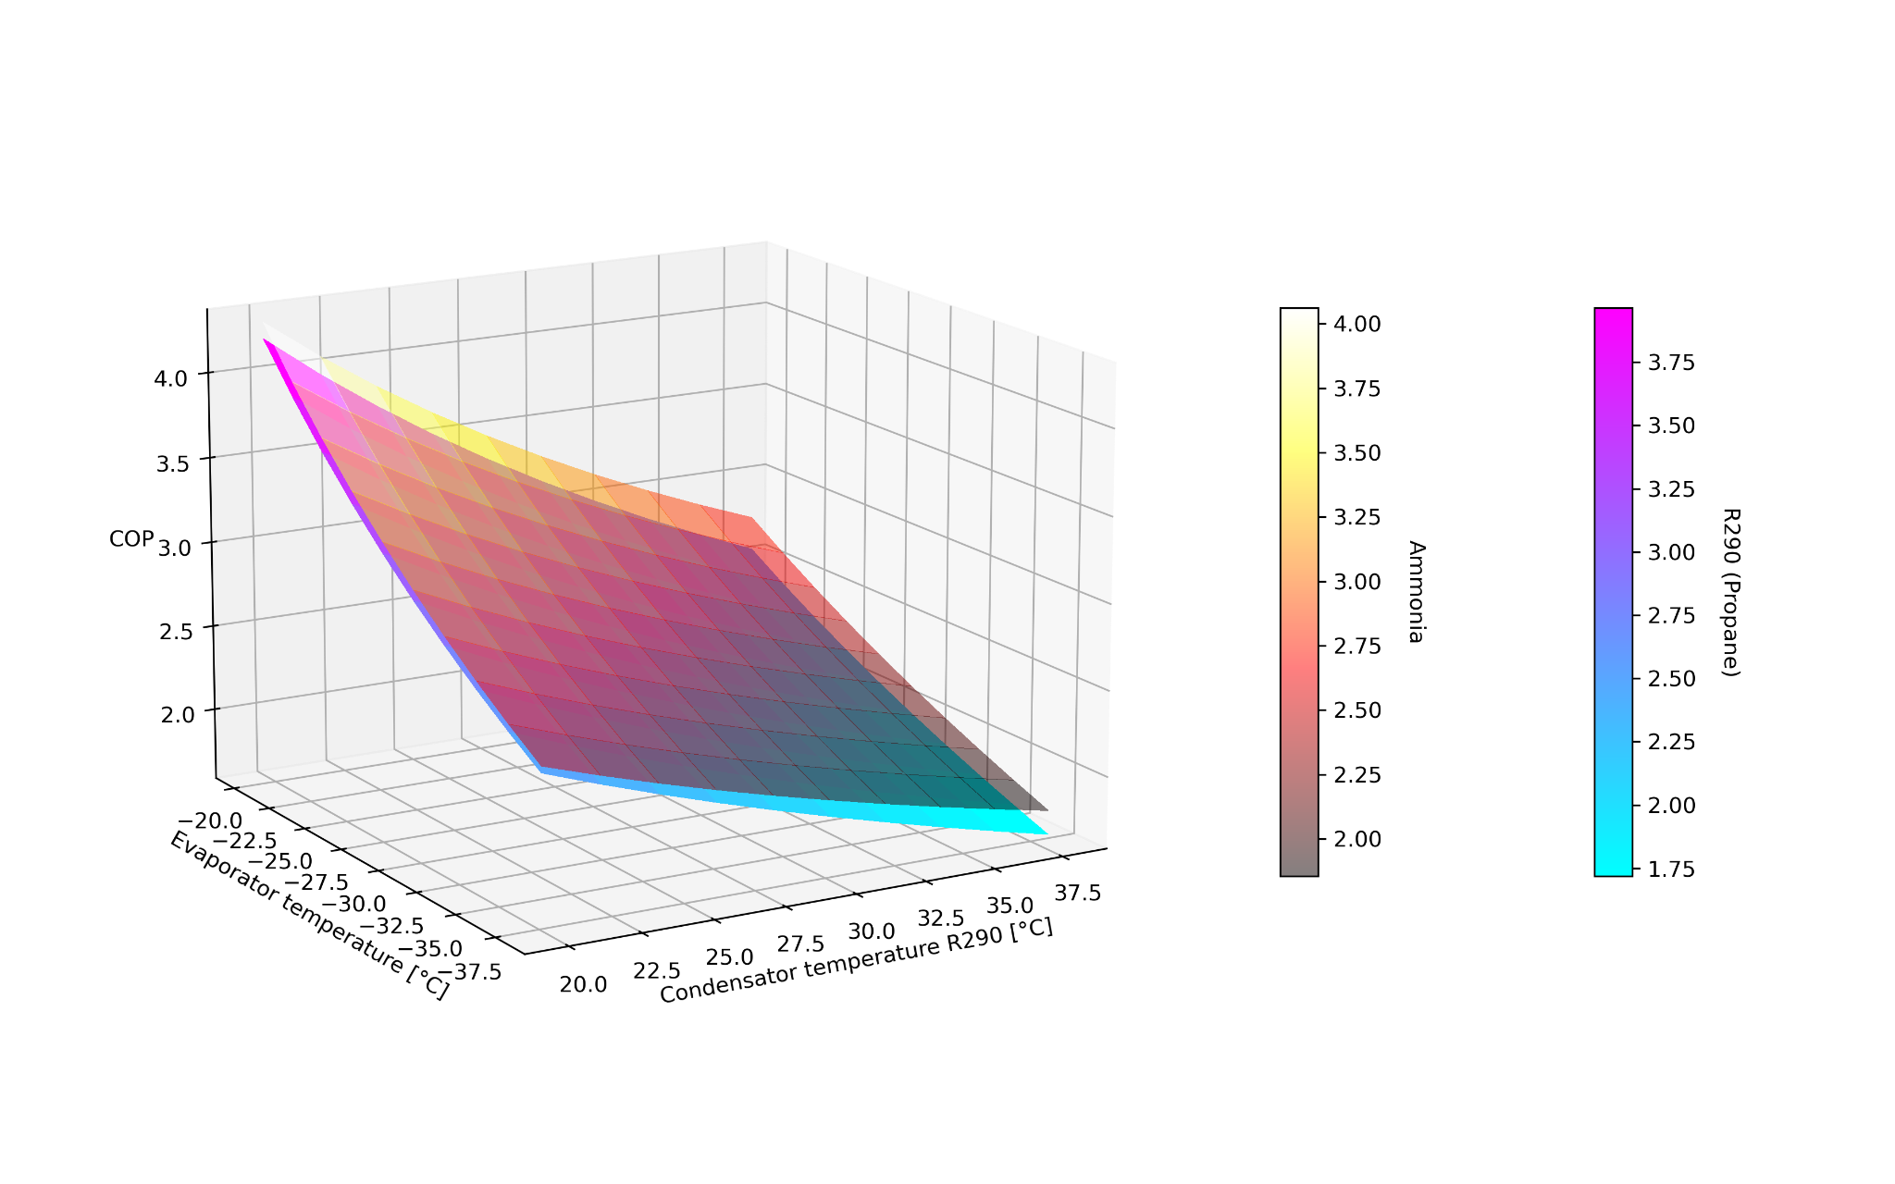
Backup Slides 〉
Notes:
Back-up Slide: Explain how the high COP relates to low evap temp and high condens temp.

